Slide 1

Ok, That’s the Principle of Least Knowledge
Of Course not

Slide 2
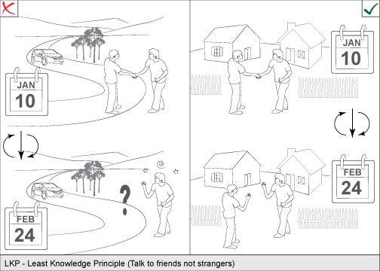
Ok, That’s the Real Principle of Least Konwledge

Slide 3
Introduction
The Law of Demeter (LoD) or principle of least knowledge is a design guideline for developing software, particularly object-oriented programs. In its general form, the LoD is a specific case of loose coupling. The guideline was proposed at Northeastern University towards the end of 1987, and can be succinctly summarized in each of the following ways:
Each unit should have only limited knowledge about other units: only units "closely" related to the current unit.
Each unit should only talk to its friends; don't talk to strangers.
Only talk to your immediate friends.
----from Wikipedia

Slide 4
Friend and Stranger
the Law of Demeter for functions requires that a method m of an object O may only invoke the methods of the following kinds of objects:
O itself
m's parameters
Any objects created/instantiated within m
O's direct component objects
A global variable, accessible by O, in the scope of m
----from Wikipedia

Slide 5

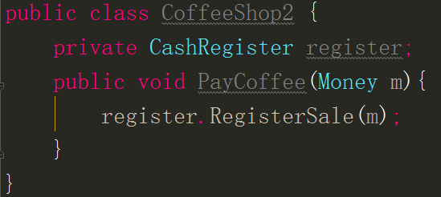
Don’t look for thing , ask for you want

Slide 6
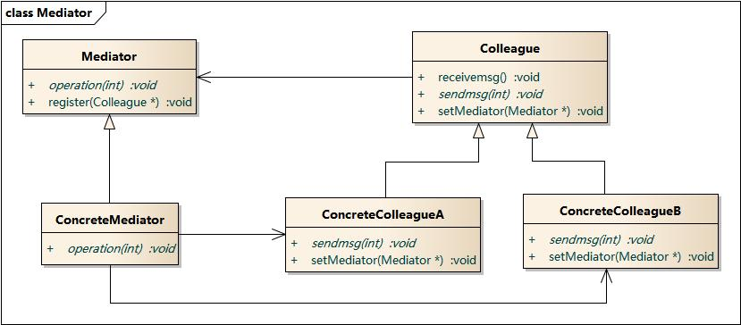
Mediator pattern

Slide 7
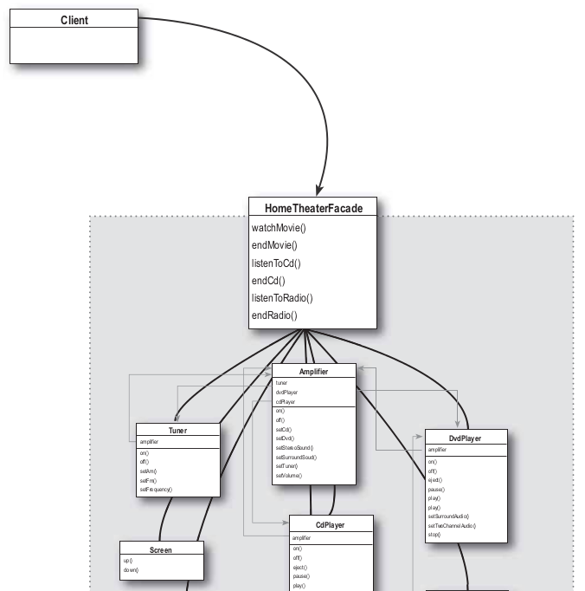
Facade Pattern

